Slide 1

Notes:
We are trying to develop a smart walking cane for the blind. Our product name is Navicane.

Slide 2
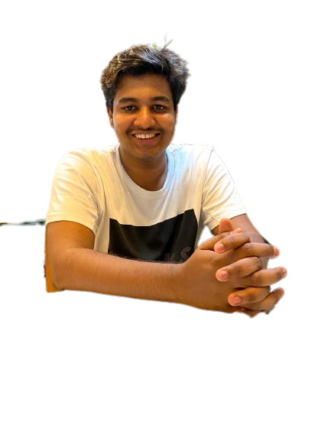
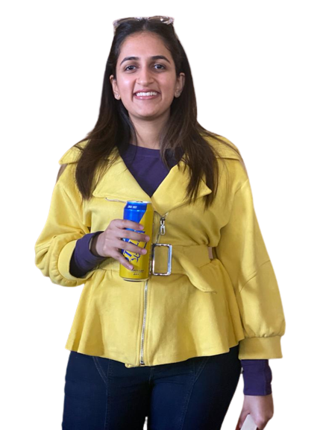
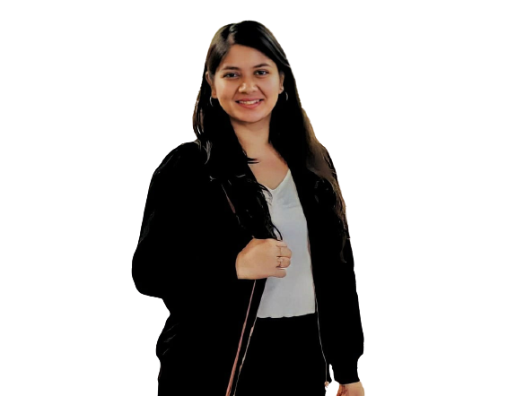
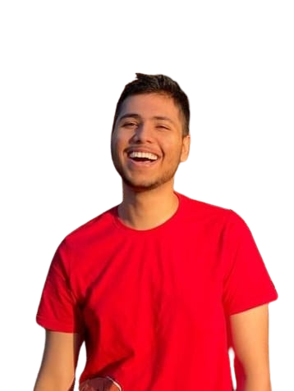
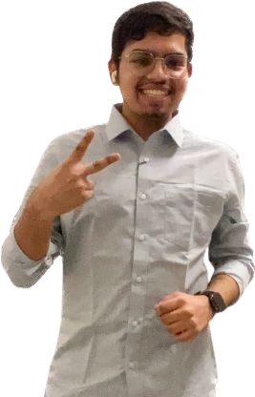
Team and Roles
Kranthi, CTO
IIT Bombay
Vigna, CEO
IIT Bombay
Nirgam, CFO
IIT Bombay
Shambhavi, COO
IIT Bombay
Sudhansh, CMO
IIT Bombay
Notes:
I am Vigna with my teammates Kranthi, Nirgam, Shambhavi and Sudhansh.

Slide 3
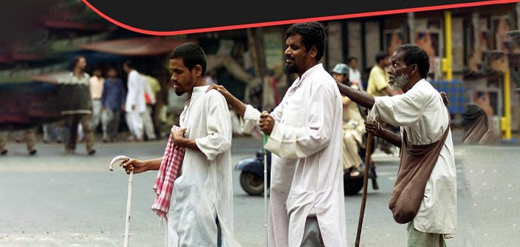
Contents
Motivation
Motivation
Current Solutions
Why canes?
Market Analysis
Target Audience
Existing Products
Customer Discovery
Our USP
Sketches
Budget
Prototype & Demo
Blind individuals face issues while basic life activities like crossing roads, climbing stairs, looking for stones or potholes, etc.
Notes:
We have witnessed blind individuals navigate freely, without any aid, among the crowded streets in Mumbai. It is not an easy feat. Our motivation to work on this idea came when one day Sudhansh saw a blind person trying to cross a road in Hiranandani. He has been standing there for a long time and was quite afraid about it as any of us will be if our eyesight is taken from us.

Slide 4
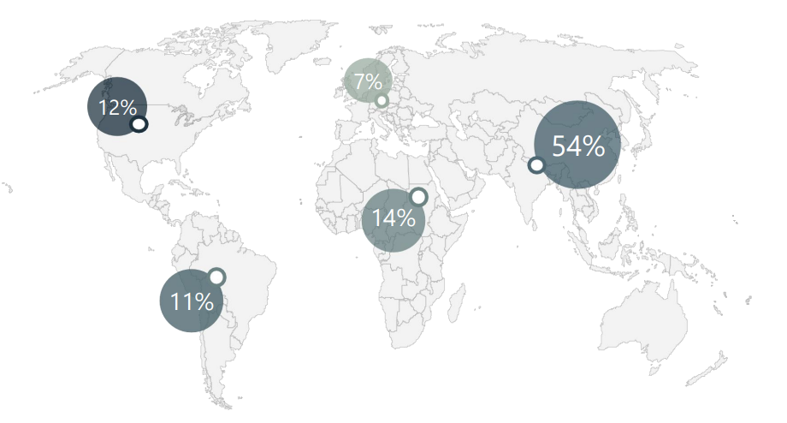
Contents
Motivation
Motivation
Current Solutions
Why canes?
Market Analysis
Target Audience
Existing Products
Customer Discovery
Our USP
Sketches
Budget
Prototype & Demo
220 million visually impaired people globally
India has the largest blind population (~ 54%)
Notes:
There are approximately 220 million blind people all across the globe. Of this, Indian subcontinent has the largest blind population, constituting ~54% of the total.

Slide 5
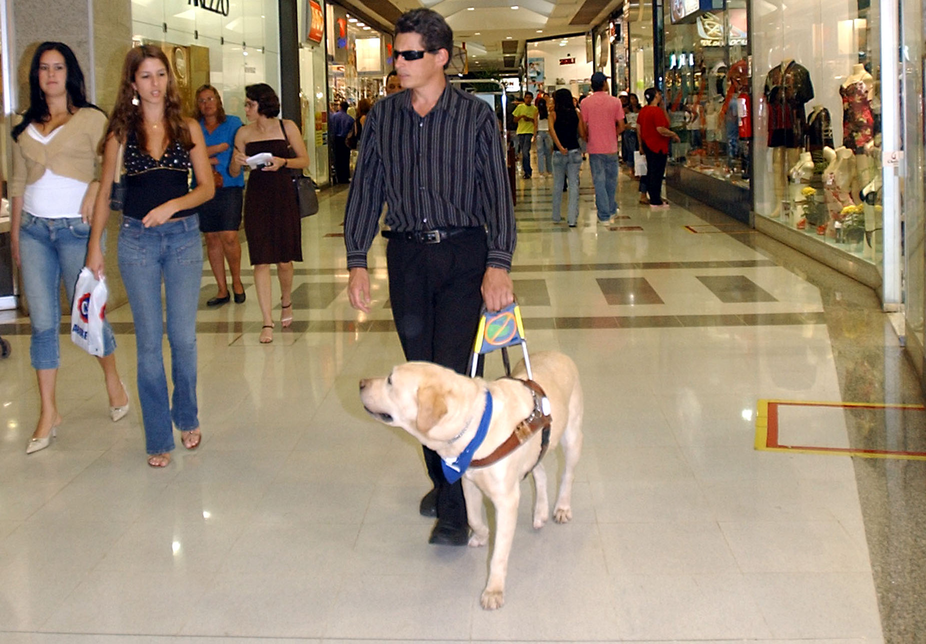
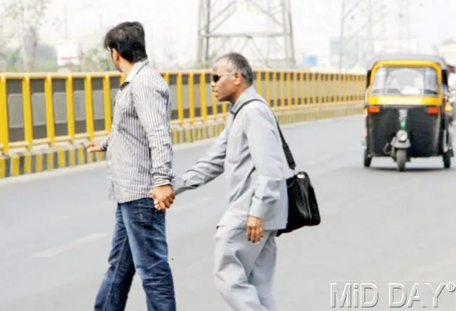
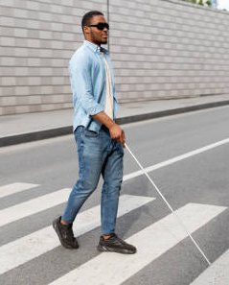
Contents
Current solutions
Motivation
Current Solutions
Why canes?
Market Analysis
Target Audience
Existing Products
Customer Discovery
Our USP
Sketches
Budget
Prototype & Demo
Guide Dogs
Human Aid
Walking Cane
Notes:
To make their life a lil easy, there have been 3 major helps - guide dogs, human aid and walking cane.

Slide 6
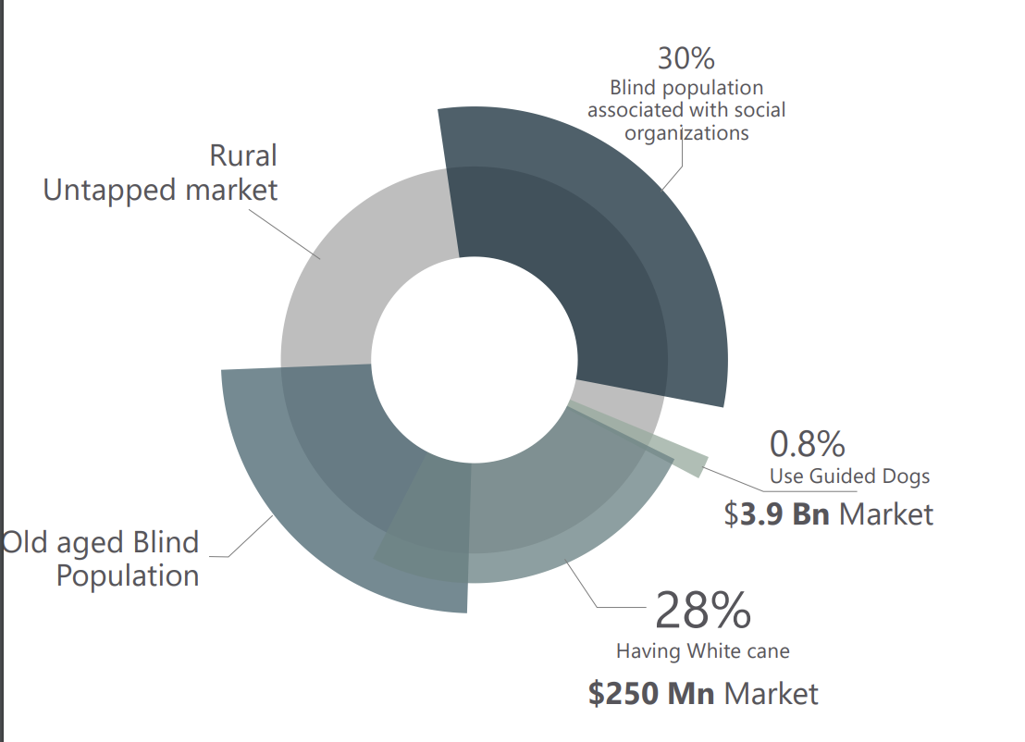
Contents
Why canes?
Motivation
Current Solutions
Why canes?
Market Analysis
Target Audience
Existing Products
Customer Discovery
Our USP
Sketches
Budget
Prototype & Demo
Canes is the most popular type of aid because -
Easily available
Cost effective
Mn
Notes:
Extend the slide with words

Slide 7
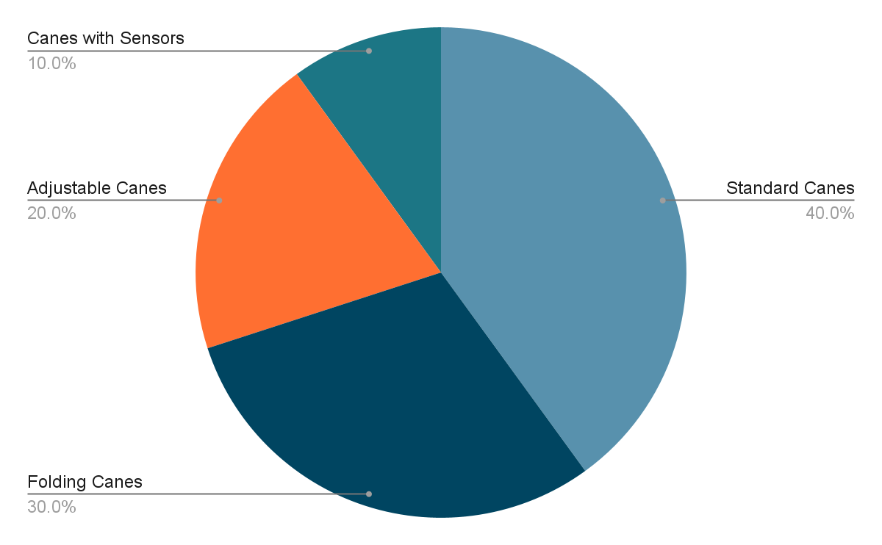
Contents
Market Analysis
Motivation
Current Solutions
Why canes?
Market Analysis
Target Audience
Existing Products
Customer Discovery
Our USP
Sketches
Budget
Prototype & Demo
Indian market ~ INR 200 crore in 2020.
Growing at a CAGR of 5% from 2021 to 2028

Slide 8
Contents
Target Audience for Our Product
Motivation
Current Solutions
Why canes?
Market Analysis
Target Audience
Existing Product
Customer Discovery
Our USP
Sketches
Budget
Prototype & Demo
B2C - Directly catering the visually impaired & blind people.
Donors who may donate to the blind people.
B2B - Hospitals & rehabilitation centers that help the blind.
Many organisations are obliged to share a part of their profits as a donations.

Slide 9
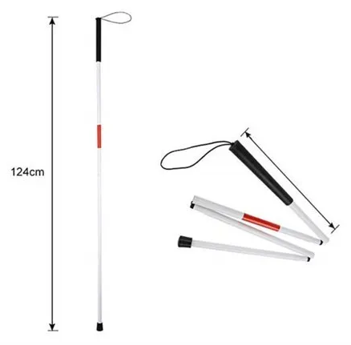
Contents
Existing Products
Motivation
Current Solutions
Why canes?
Market Analysis
Target Audience
Existing Products
Customer Discovery
Our USP
Sketches
Budget
Prototype & Demo
Non-slip
Wear resistant
Reflective Tape
Price: ~700 INR
White Cane
Notes:
There have been a few products in the market. The one which has been leading over the years is a simple foldable white cane.

Slide 10
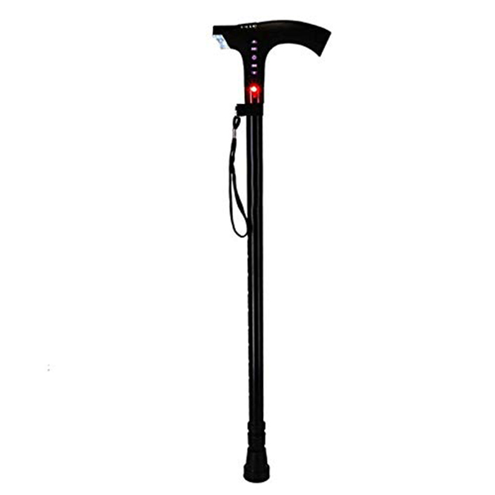
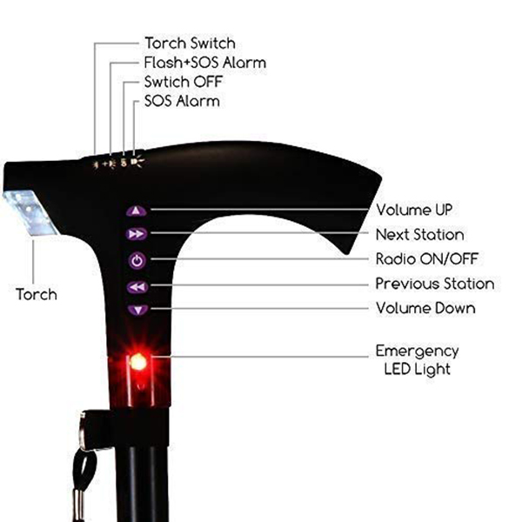
Contents
Existing Products
Motivation
Current Solutions
Why canes?
Market Analysis
Target Audience
Existing Products
Customer Discovery
Our USP
Sketches
Budget
Prototype & Demo
Adjustable height
Torch
SoS Alarm
Radio
Emergency Red Light
USB Charging
Price: ~4500 INR
Dr. Odin Cane
Notes:
On a more advance level we have a cane with a few entertainment and rescue features.

Slide 11
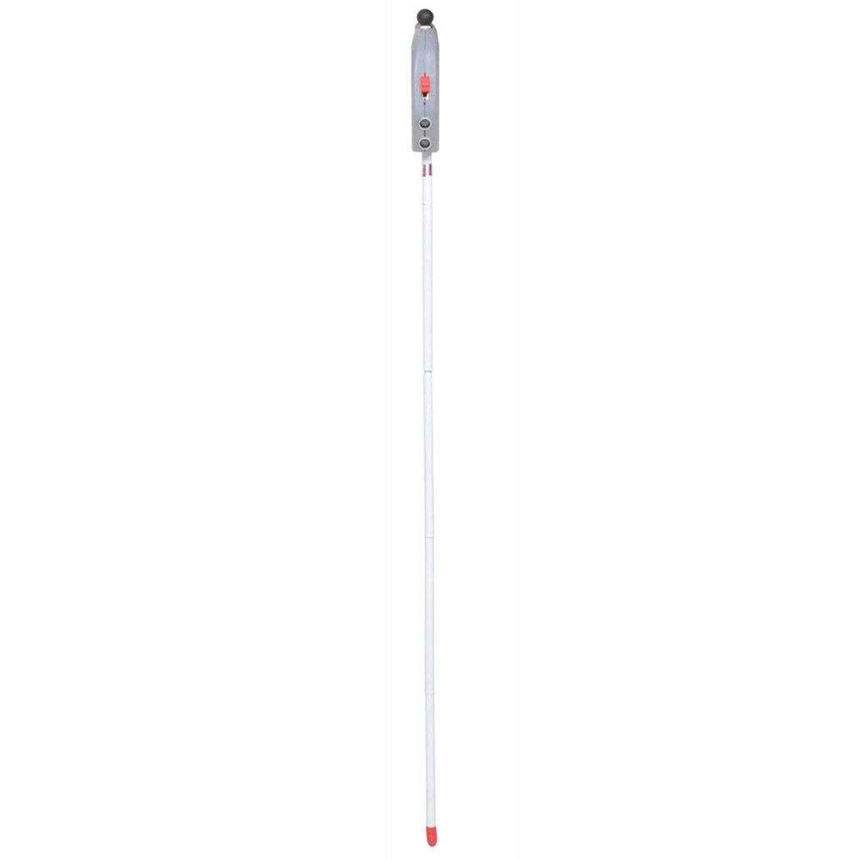
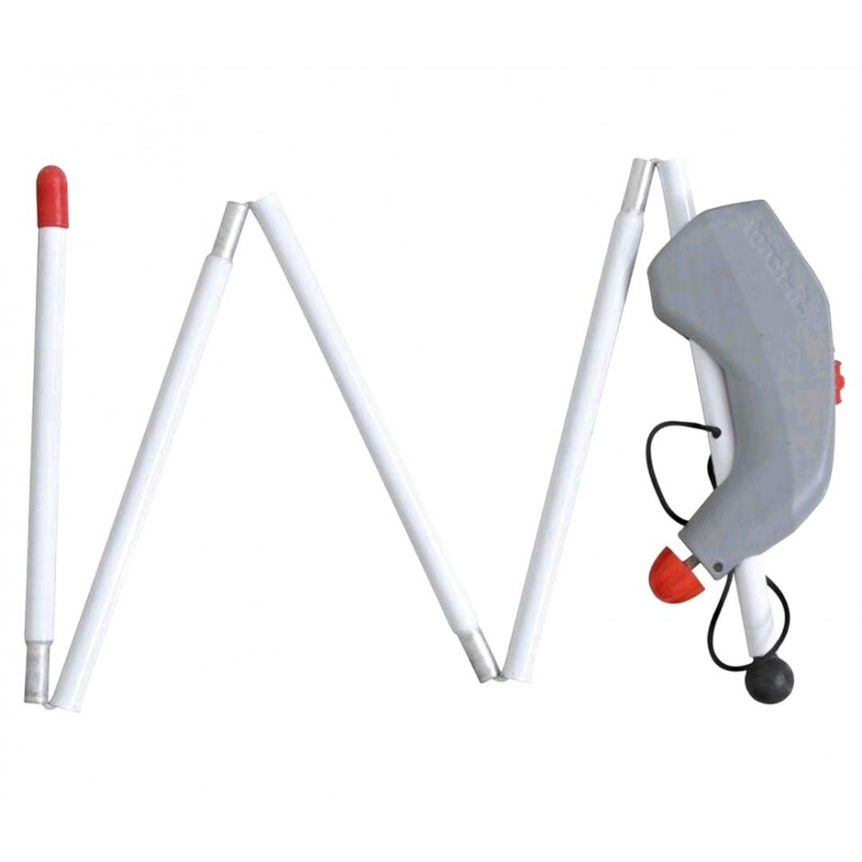
Contents
Existing Products
Motivation
Current Solutions
Why canes?
Market Analysis
Target Audience
Existing Products
Customer Discovery
Our USP
Sketches
Budget
Prototype & Demo
Object Detection (Ultrasonic sensors)
Foldable
Non-slip
Lightweight
Price: ~6000 INR
Saarthi Device
Notes:
Finally, the most advanced cane in the market helps with just object detection.

Slide 12
Contents
Existing Products
Motivation
Current Solutions
Why canes?
Market Analysis
Target Audience
Existing Products
Customer Discovery
Our USP
Sketches
Budget
Prototype & Demo
Our major competitors are -
Saarthi Torchit from Gujarat made a portable device
SmartCane from IIT Delhi
Neptune Systems from Pune
Notes:
The major competitors in the market of smart canes are - Saarthi Torchit, SmartCane and Neptune Systems. But they haven’t tapped the market all across the country and are still at very primitive level.

Slide 13
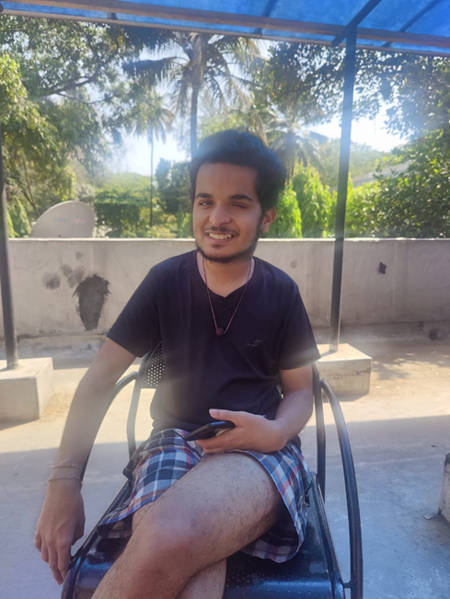
Contents
Customer Discovery
Motivation
Current Solutions
Why canes?
Market Analysis
Target Audience
Existing Products
Customer Discovery
Our USP
Sketches
Budget
Prototype & Demo
“Hey, I am Aditya and I am a Sophomore at IIT Bombay.”
Depth Perception is a great way to tackle my fear of stairs and slopes.
The stick would also help me balancing and placing my steps.
Face recognition would be a great way to know my friends.
Notes:
Once we had a rough idea about our product, we started to contact our customers and get their reviews about our product. We contacted several institutes for the blind and approximately 6-7 individuals too. We have added the ones whom gave the most helpful suggestions which helped us to shape our product better. It really helped and made us understand the difficulties with existing products. Our first customer was Aditya, he is a 2nd year student at IIT Bombay. He suggested that the most essential feature was depth perception in the product which hasn’t been implemented till date.

Slide 14
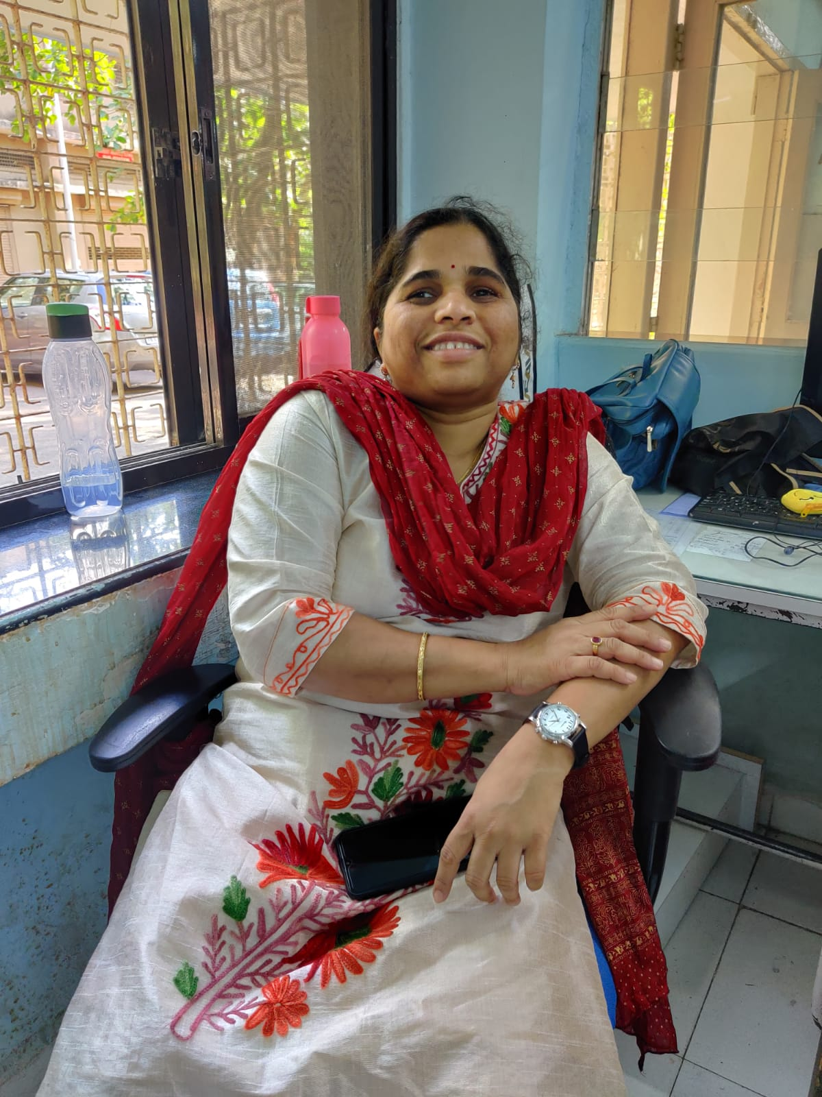
Contents
Customer Discovery
Motivation
Current Solutions
Why canes?
Market Analysis
Target Audience
Existing Products
Customer Discovery
Our USP
Sketches
Budget
Prototype & Demo
“I am Pallavi and I work at the IITB Hospital”
GPS Integration will really help me to get to the hospital daily.
Different vibrations/beeps to identify the kind of obstacle.
Wide angle for the sensors to cover a larger area.
Notes:
Our second customer was Pallavi mam, she works at the IITB hospital. According to her, GPS Integration was the feature she liked the most and would love to have in a cane so that she could navigate more confidently.

Slide 15
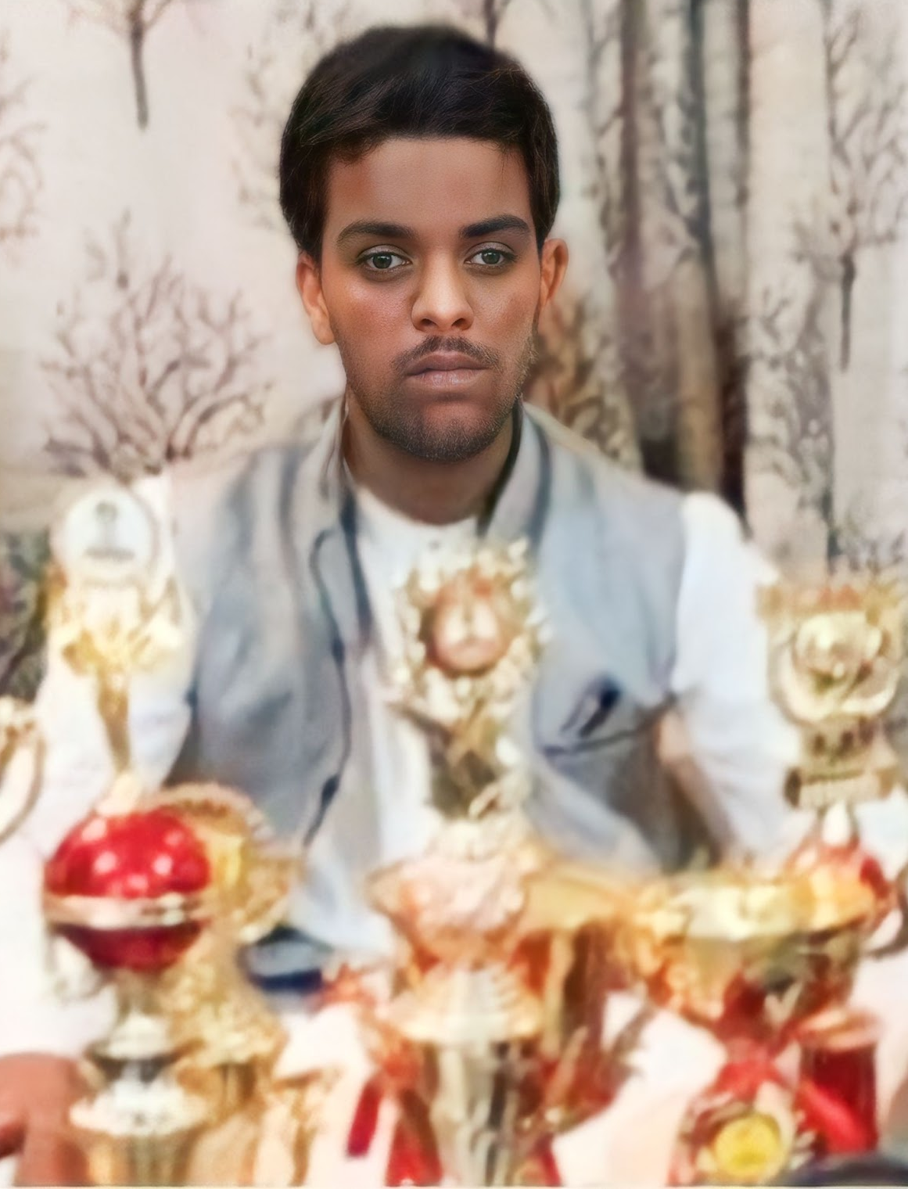
Contents
Customer Discovery
Motivation
Current Solutions
Why canes?
Market Analysis
Target Audience
Existing Products
Customer Discovery
Our USP
Sketches
Budget
Prototype & Demo
“I am Pranit and I am a final year CA student”
Roller on bottom of the stick will help me to look for smaller potholes, rocks, etc.
Try to make the cane wear resistant and waterproof.
Connectivity to mobile/smart watch.
Notes:
Our next customer was Pranit, a final year CA student. He is really interested in abacus and has won many awards for the same and even has world records in his name. He suggested to add a roller at the bottom of the stick to look for small potholes and rocks and suggested to extend functionality for connecting to mobiles and smart watches.

Slide 16
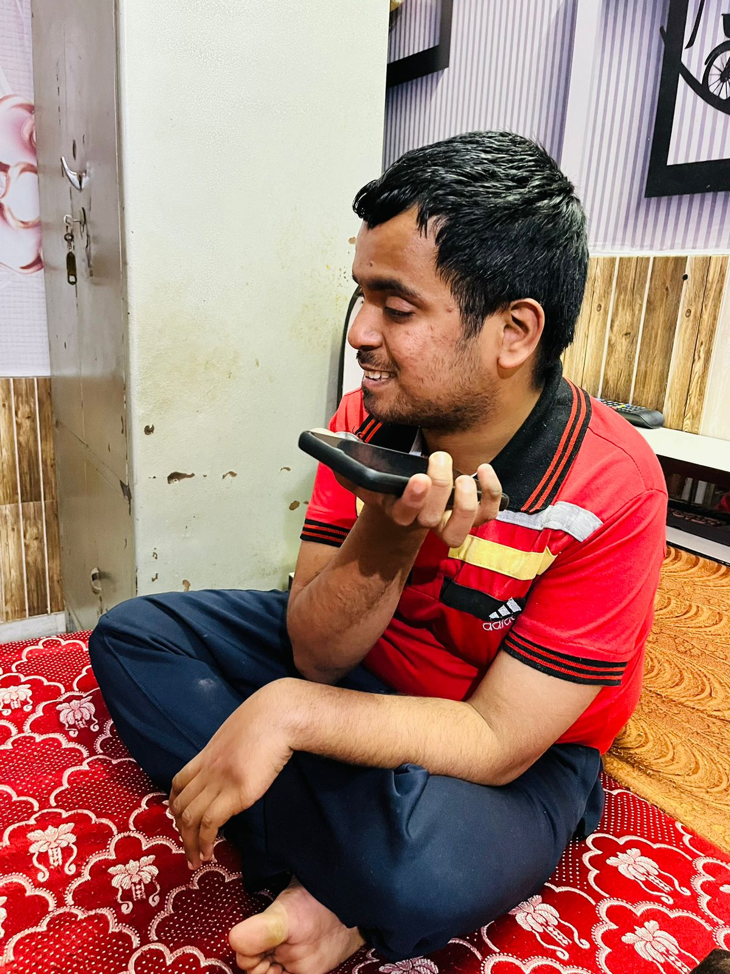
Contents
Customer Discovery
Motivation
Current Solutions
Why canes?
Market Analysis
Target Audience
Existing Products
Customer Discovery
Our USP
Sketches
Budget
Prototype & Demo
“I am Rahul Kumar, 24 from Bathinda. I have stopped my education due to a paralysis attack in eighth grade. I do not go out much and definitely not alone.”
Obstacle detection will help me overcome my fear of tripping and falling over.
Overall features may allow me to step out of the house alone.
Time feature would be very helpful.
Notes:
Our last customer was Rahul Kumar, a 24 year old. He also suggested that if navicane is developed then it will really boost his confidence and help him step outside his home without fear.

Slide 17

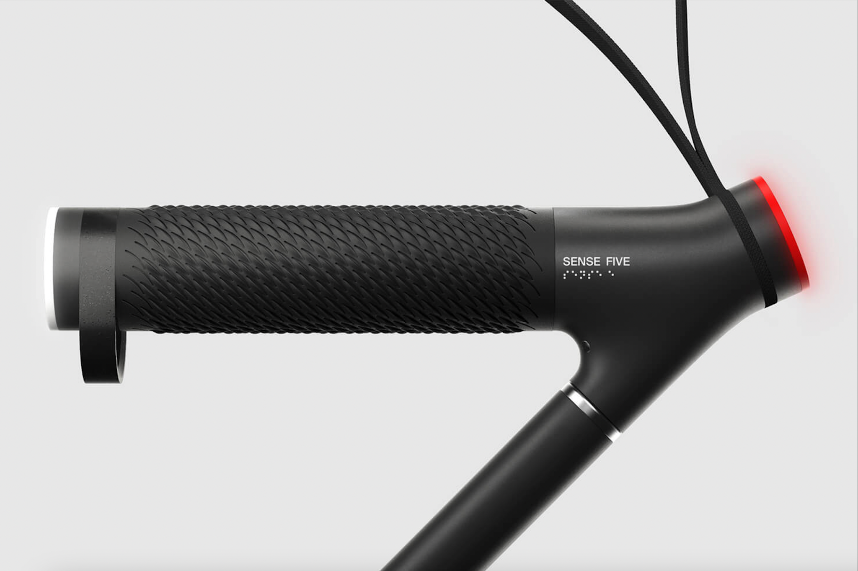
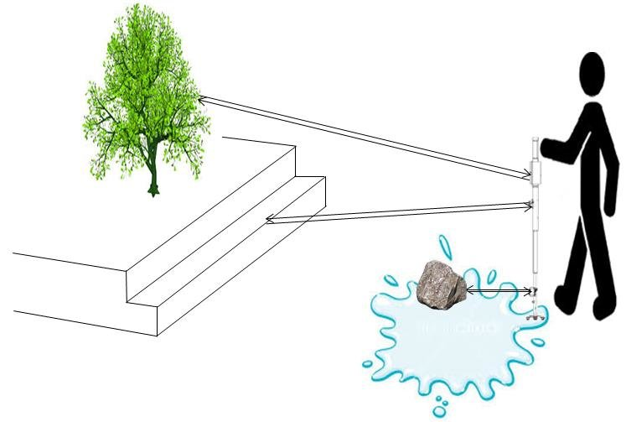
Contents
Our USP
Motivation
Current Solutions
Why canes?
Market Analysis
Target Audience
Existing Products
Customer Discovery
Our USP
Sketches
Budget
Prototype & Demo
Based on the feedback from the customers, we went ahead and finalized the following features -
GPS Integration
Camera & ultrasonic sensor for obstacle & depth perception
Different beeps/vibrations for different objects.
Roller at the base
Time feature

Slide 18
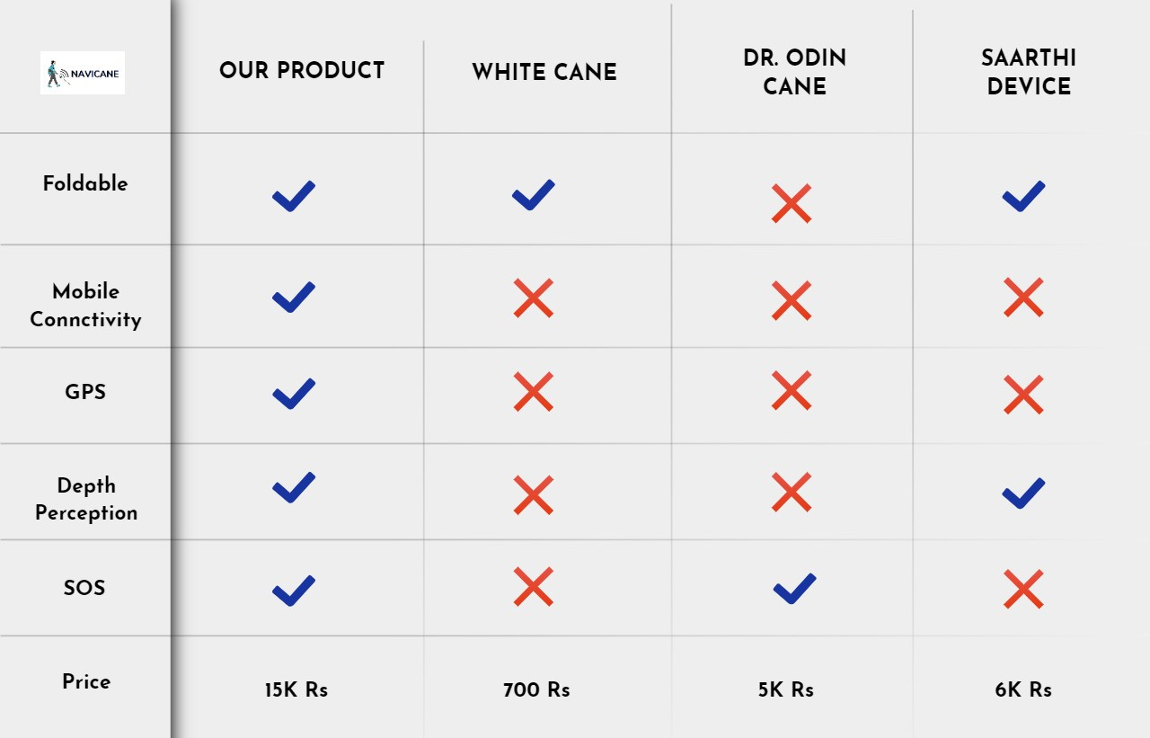
Contents
Our USP
Motivation
Current Solutions
Why canes?
Market Analysis
Target Audience
Existing Products
Customer Discovery
Our USP
Sketches
Budget
Prototype & Demo
Notes:
Only talk about the strengths not about the weaknesses.
Our advantage over our competitors and in what way we beat them.

Slide 19
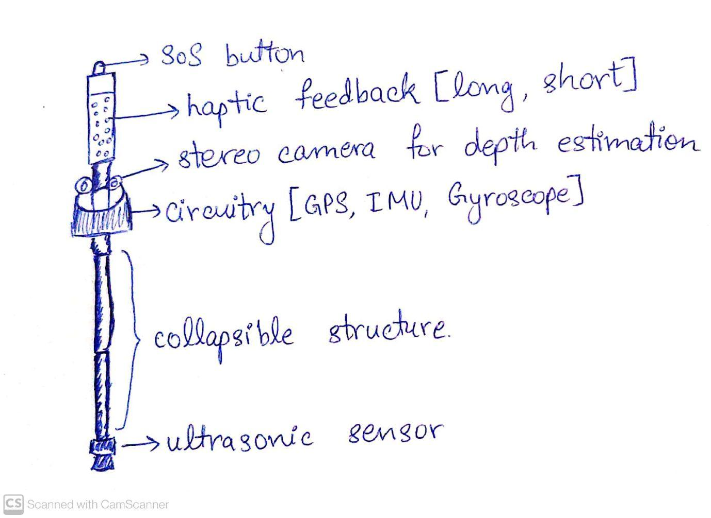
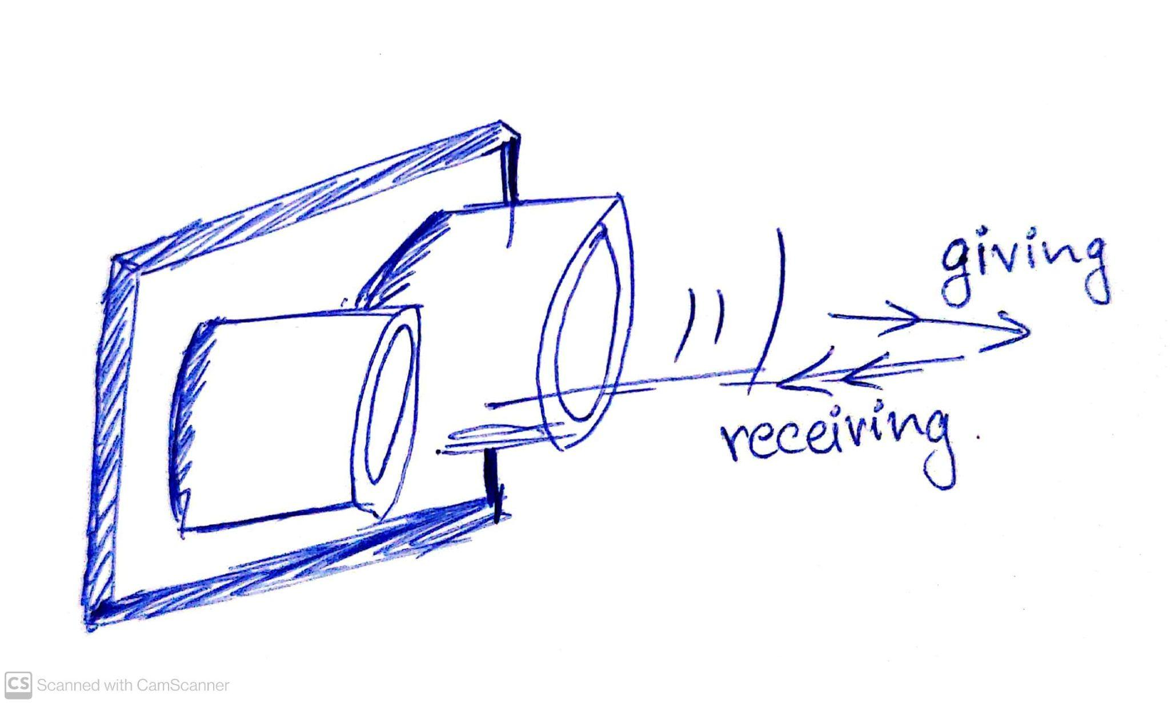
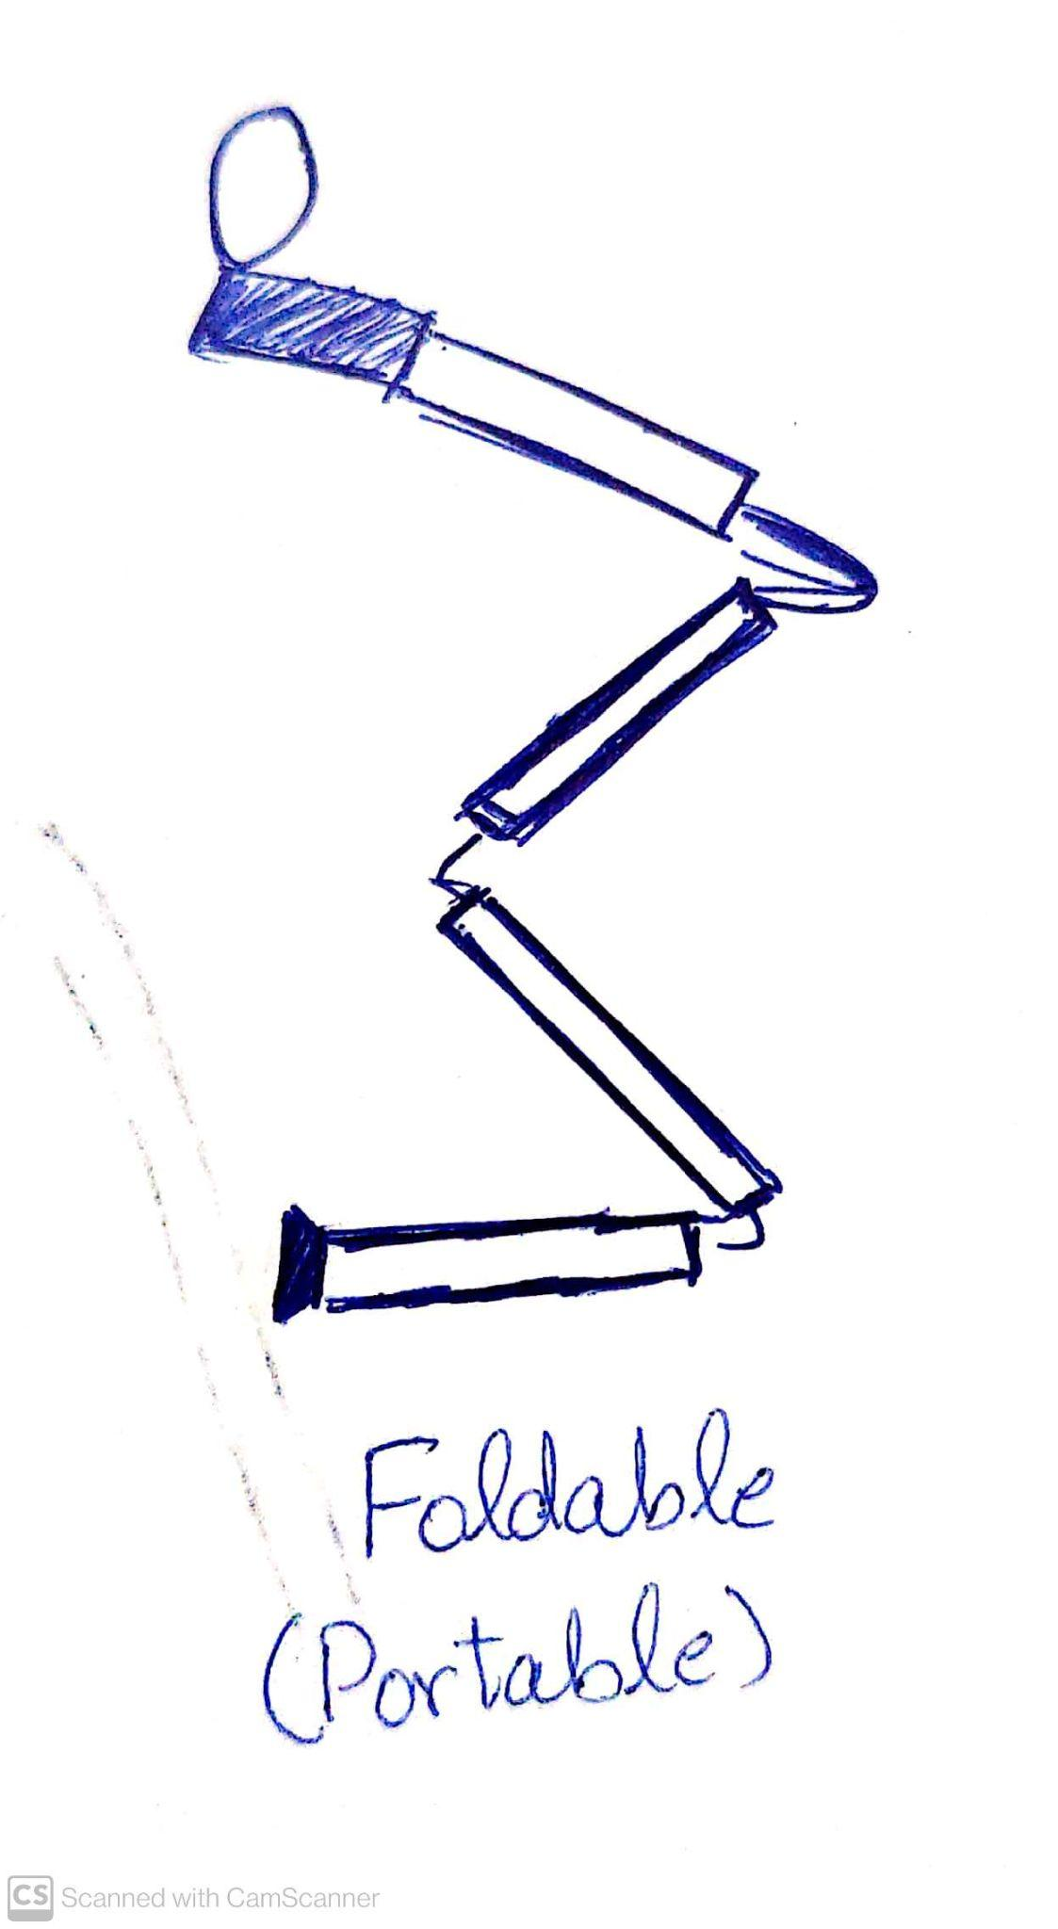
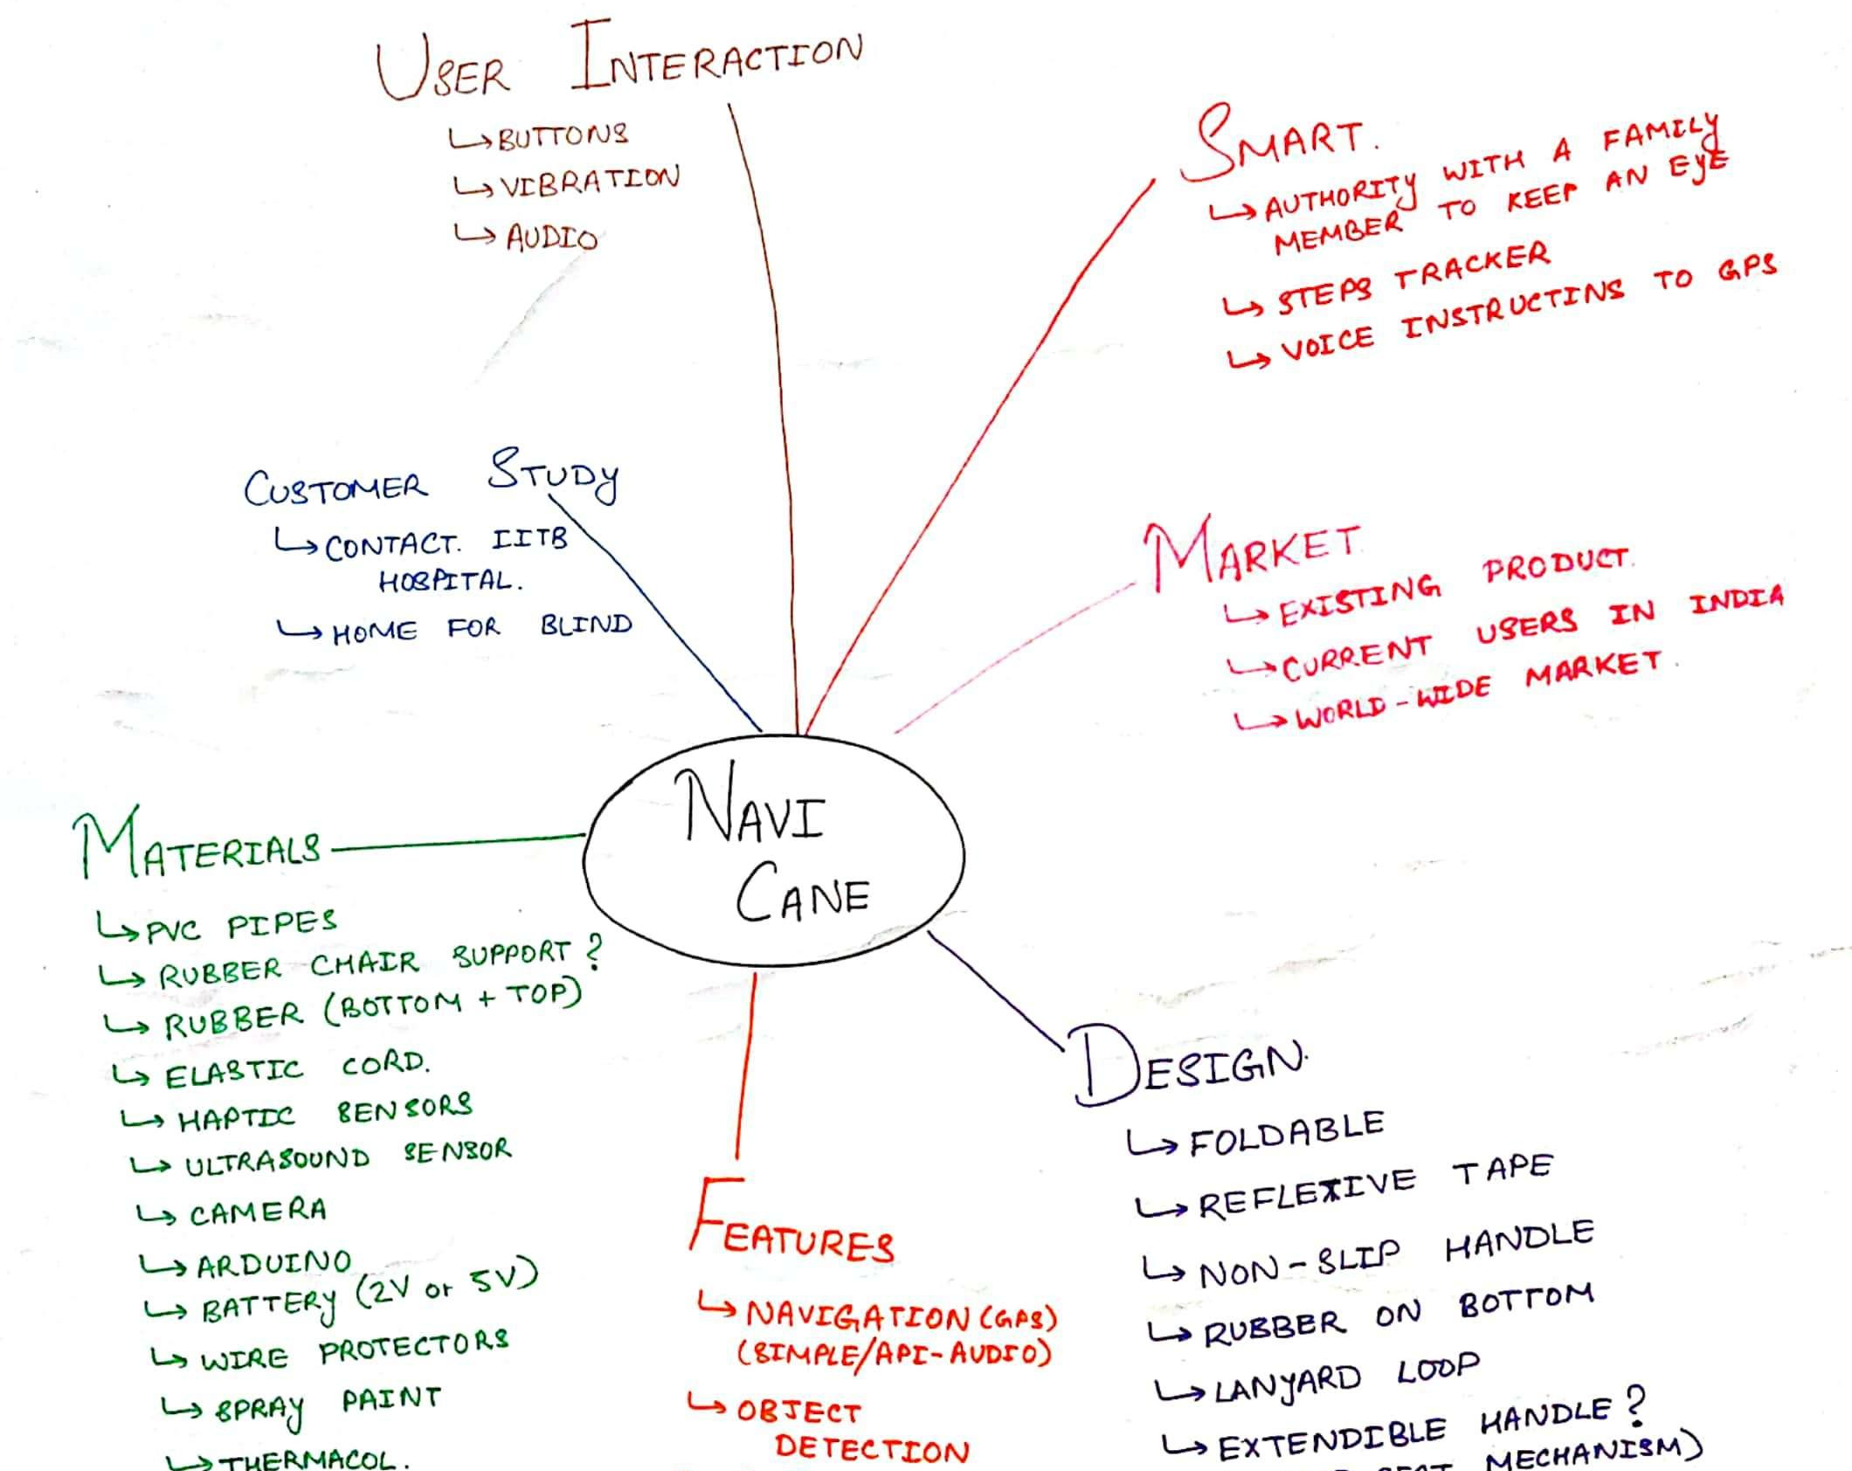
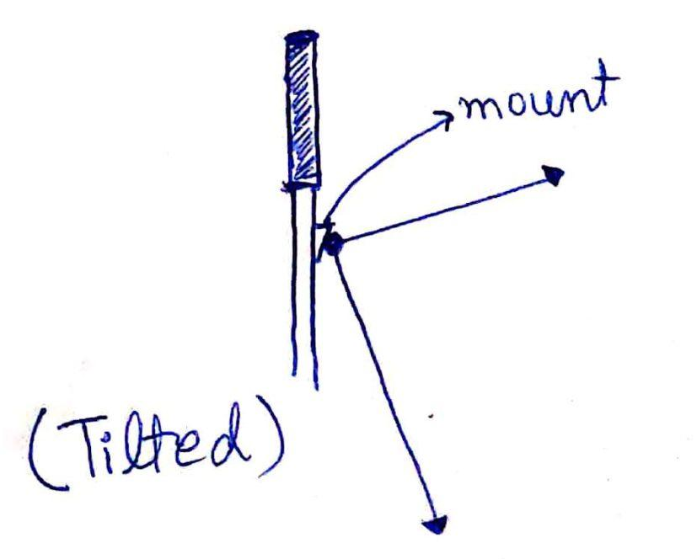
Contents
Sketches
Motivation
Current Solutions
Why canes?
Market Analysis
Target Audience
Existing Products
Customer Discovery
Our USP
Sketches
Budget
Prototype & Demo

Slide 20
Contents
Budget for the PoC Prototype
Motivation
Current Solutions
Why canes?
Market Analysis
Target Audience
Existing Products
Customer Discovery
Our USP
Sketches
Budget
Prototype & Demo
Item | Price (in INR)
PVC Pipe | 1000
IMU, GPS, Camera, Motors, Ultrasonic | 8000
Raspberry Pi, Battery | 8000
Contingency | 3000
Total Budget | 20000

Slide 21
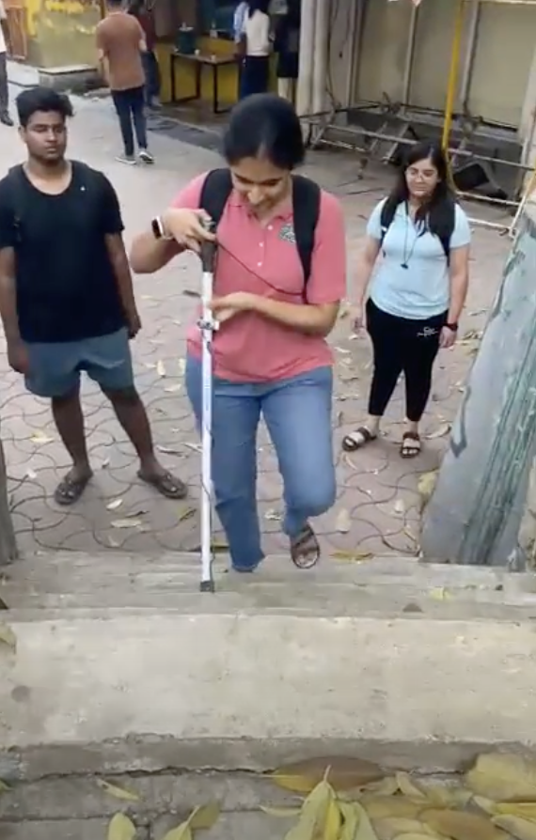
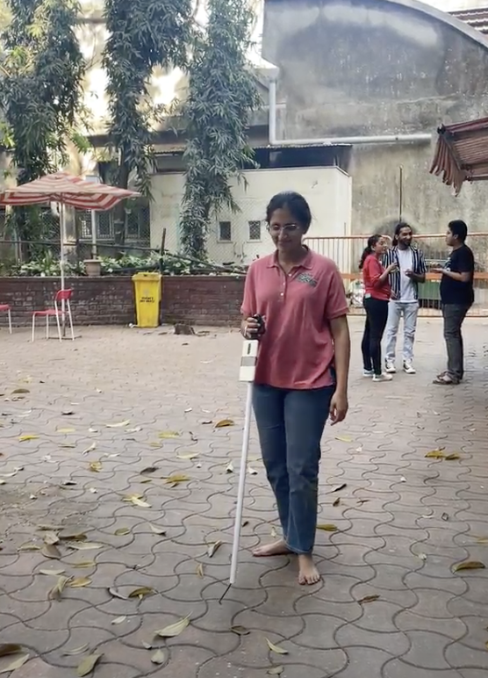
Contents
Prototype and Demo
Motivation
Current Solutions
Why canes?
Market Analysis
Target Audience
Existing Products
Customer Discovery
Our USP
Sketches
Budget
Prototype & Demo
Trying to climb the stairs
Walking on plain surface

Slide 22
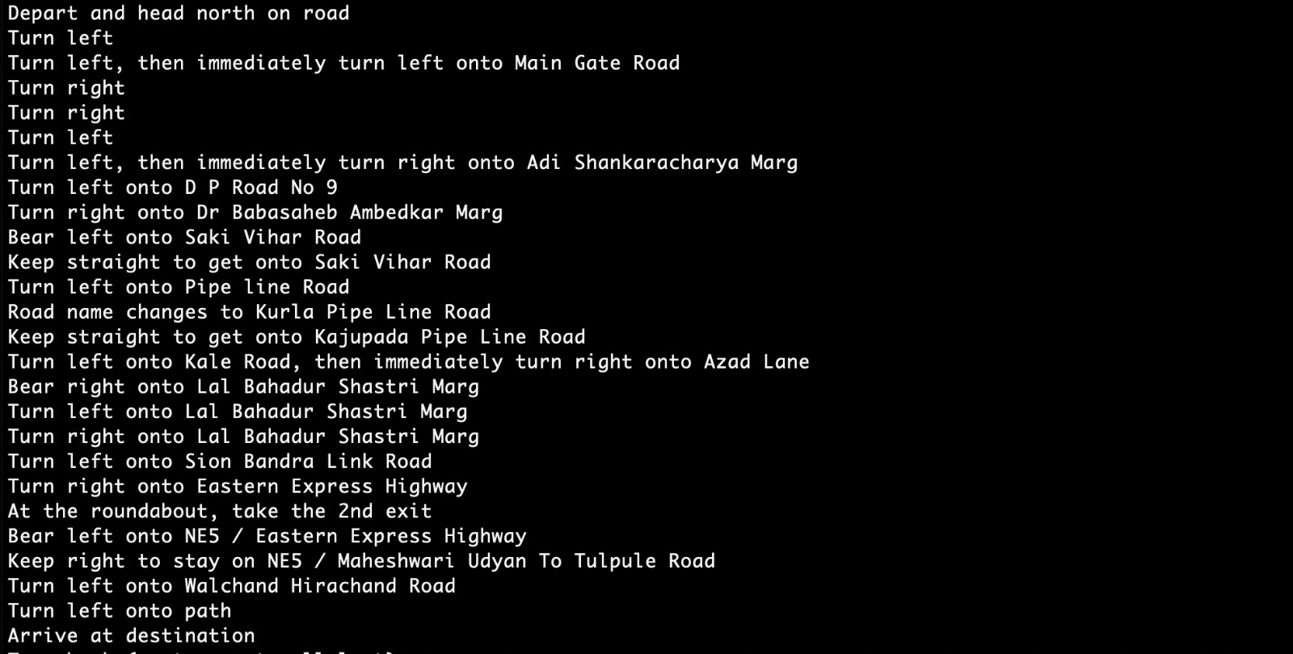
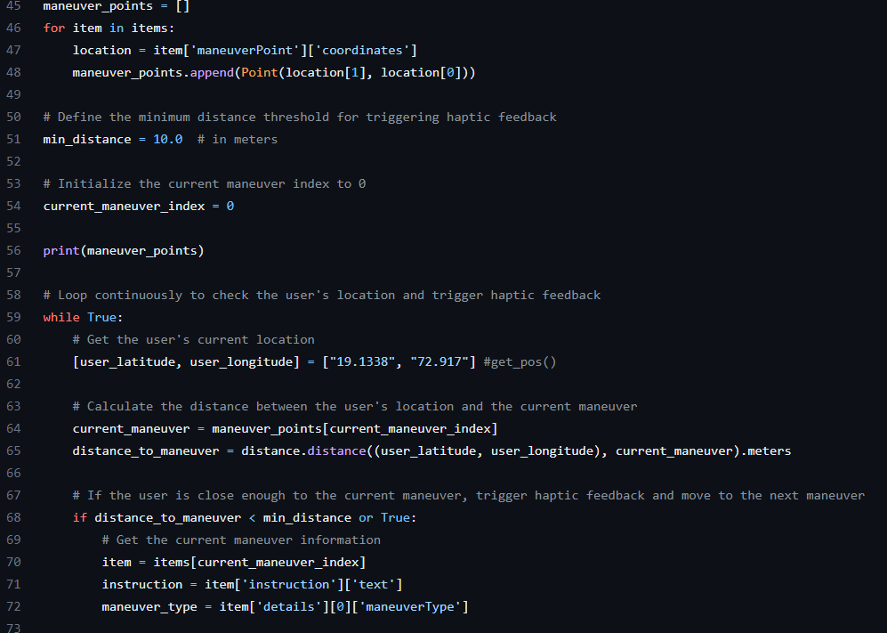
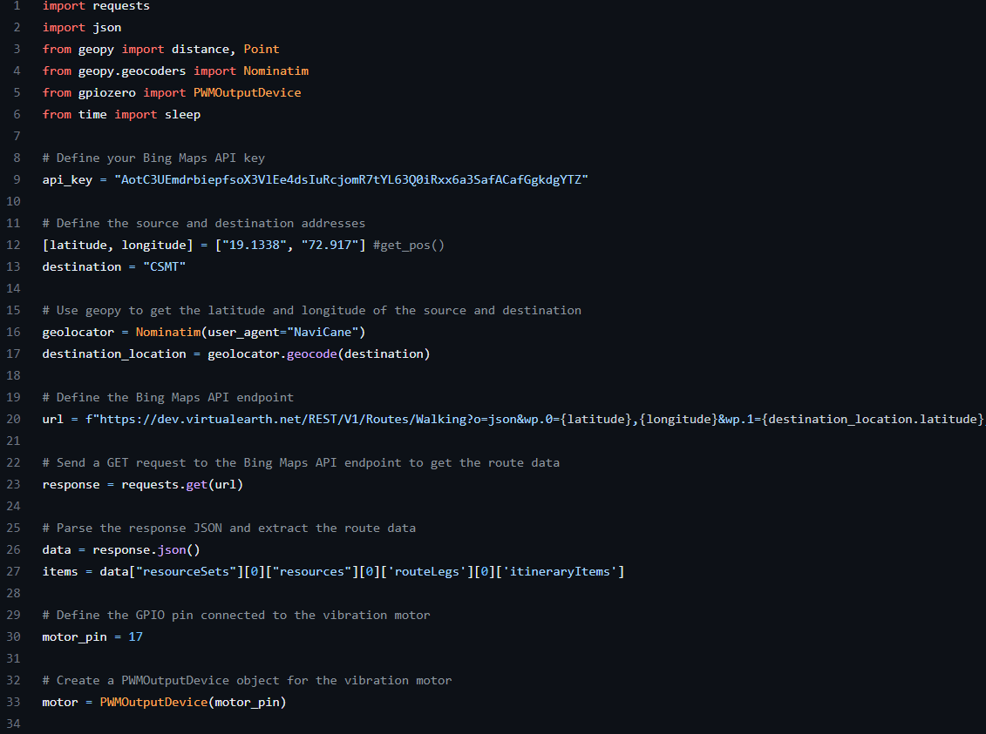
Contents
Prototype and Demo
Motivation
Current Solutions
Why canes?
Market Analysis
Target Audience
Existing Products
Customer Discovery
Our USP
Sketches
Budget
Prototype & Demo

Slide 23
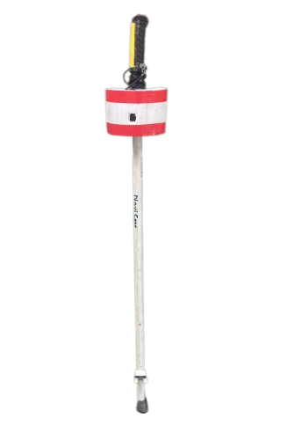
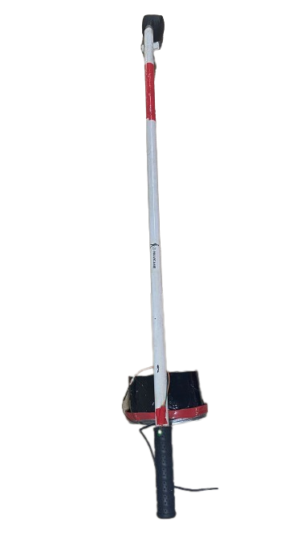
Contents
Prototype and Demo
Motivation
Current Solutions
Why canes?
Market Analysis
Target Audience
Existing Products
Customer Discovery
Our USP
Sketches
Budget
Prototype & Demo

Slide 24
Contents
Motivation
Current Solutions
Why canes?
Market Analysis
Target Audience
Existing Products
Customer Discovery
Our USP
Sketches
Budget
Prototype & Demo
Demo

Slide 25
Thank you!
Contents
Motivation
Current Solution
Why canes?
Market Analysis
Cost Analysis
Existing Product
Customer Review
Our USP
Sketches
Budget
Prototype & Demo

Slide 26
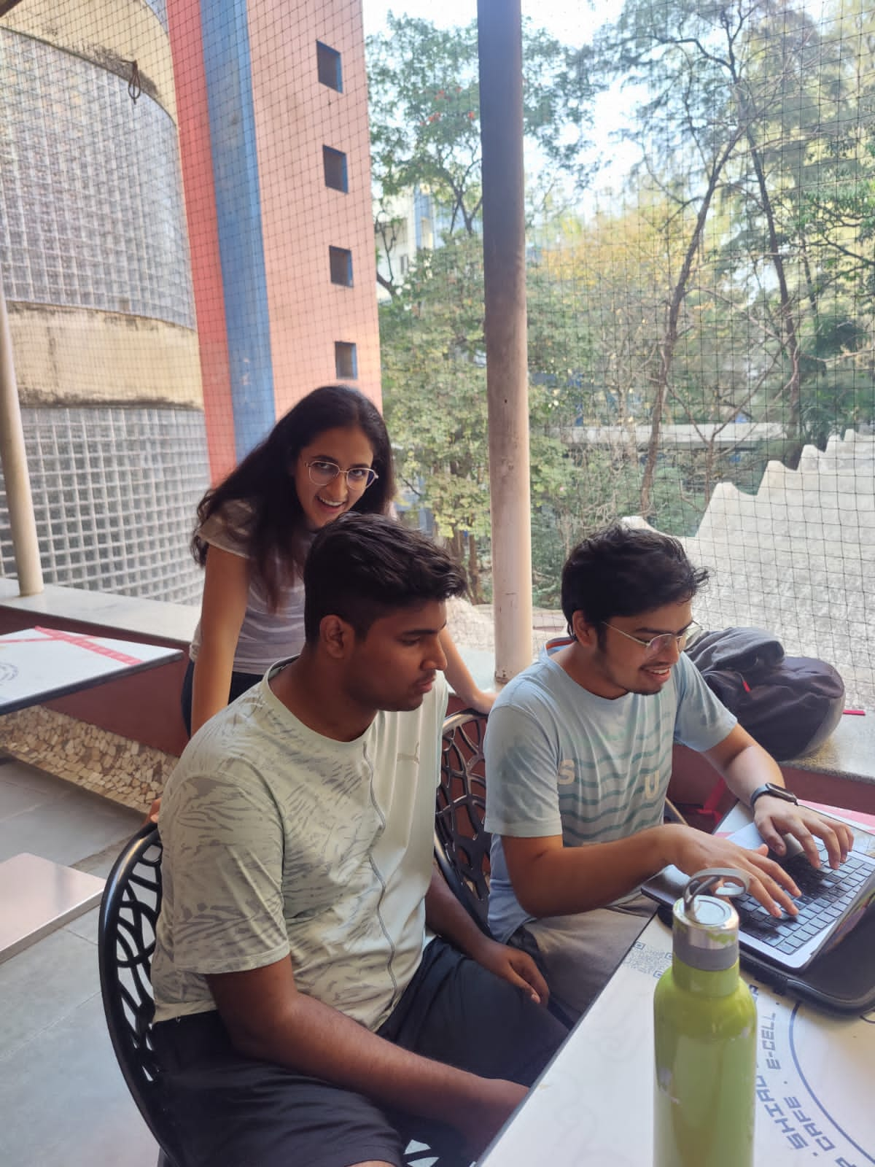
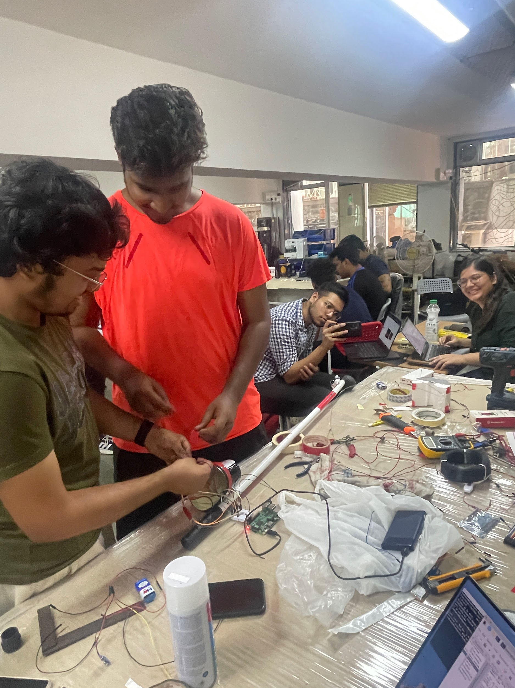
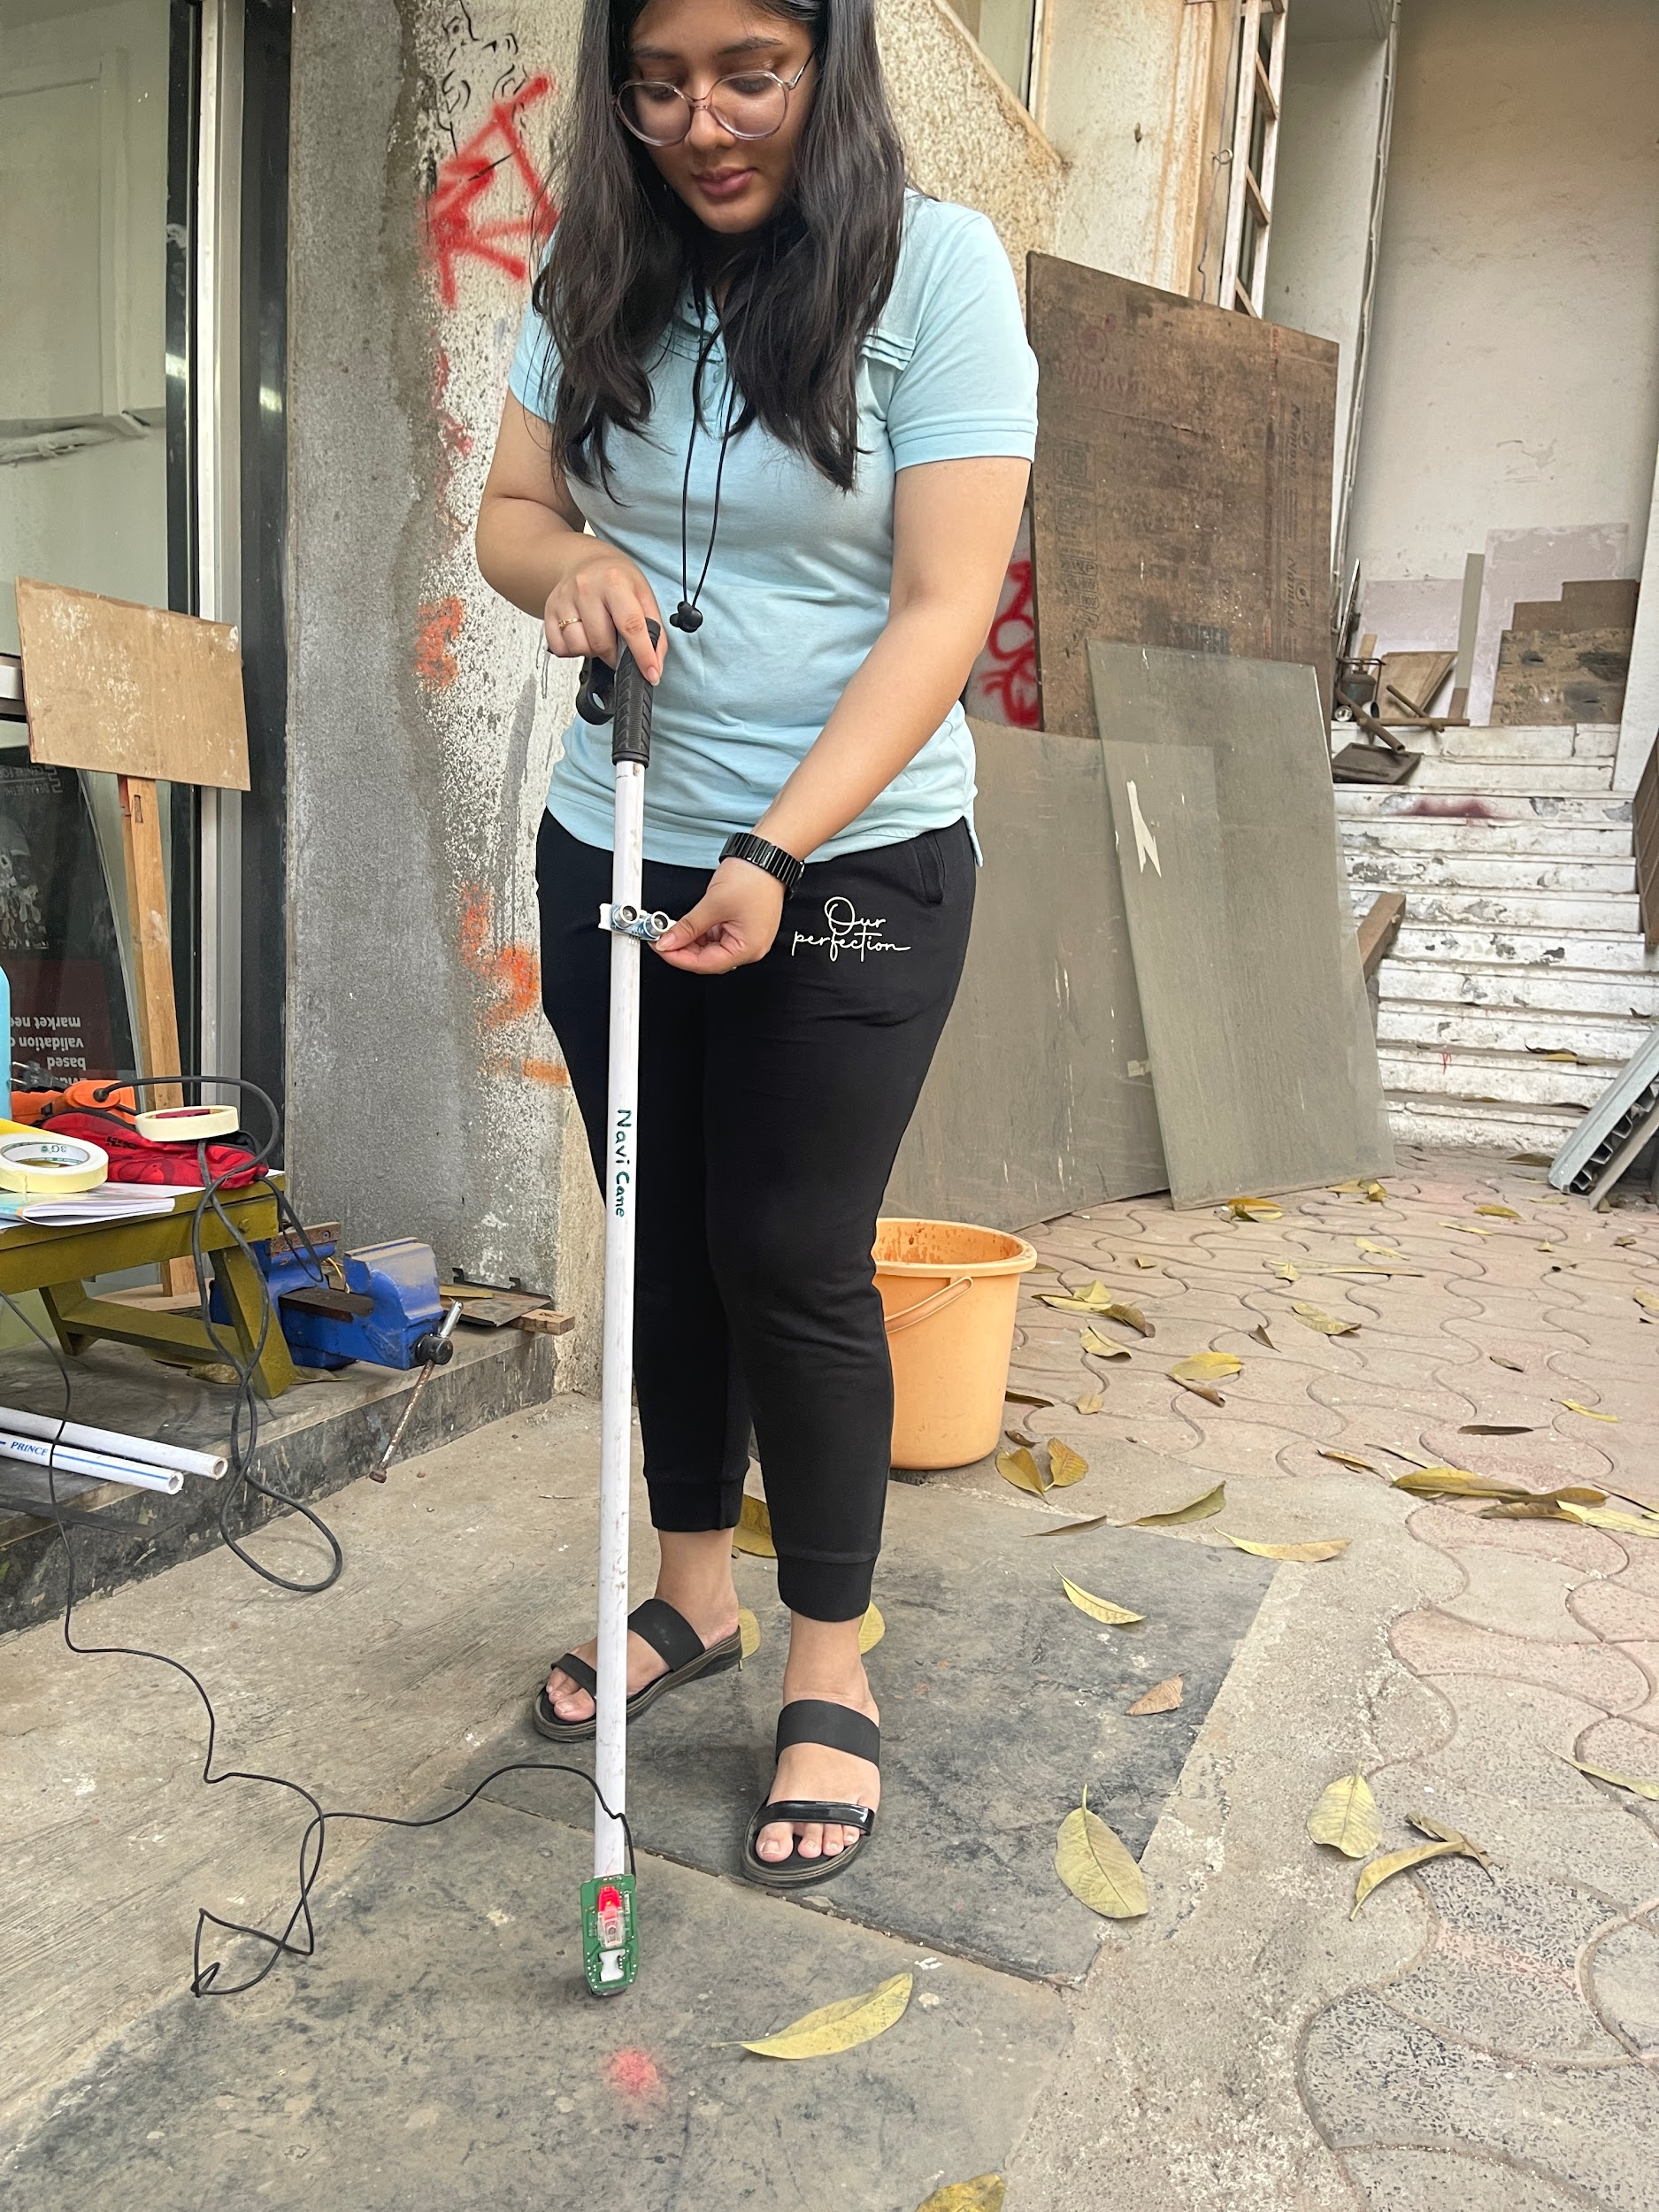
Contents
Behind The Scenes
Motivation
Current Solution
Why canes?
Market Analysis
Cost Analysis
Existing Product
Customer Review
Our USP
Sketches
Budget
Prototype & Demo

Slide 27
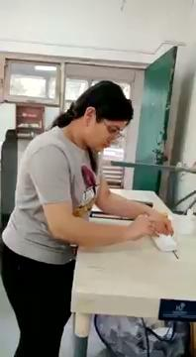
Contents
Behind The Scenes
Motivation
Current Solution
Why canes?
Market Analysis
Cost Analysis
Existing Product
Customer Review
Our USP
Sketches
Budget
Prototype & Demo

Slide 28
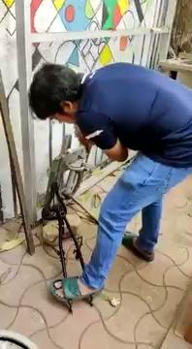
Contents
Behind The Scenes
Motivation
Current Solution
Why canes?
Market Analysis
Cost Analysis
Existing Product
Customer Review
Our USP
Sketches
Budget
Prototype & Demo

Slide 29
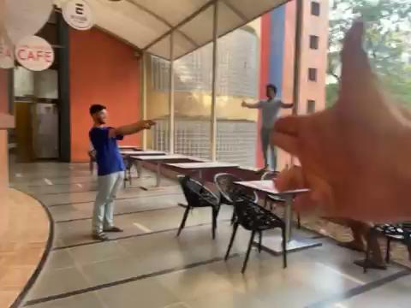
Contents
Behind The Scenes
Motivation
Current Solution
Why canes?
Market Analysis
Cost Analysis
Existing Product
Customer Review
Our USP
Sketches
Budget
Prototype & Demo
Execution Plan
(chatgpt 4 - multimodal)

Slide 30
